Slide 1

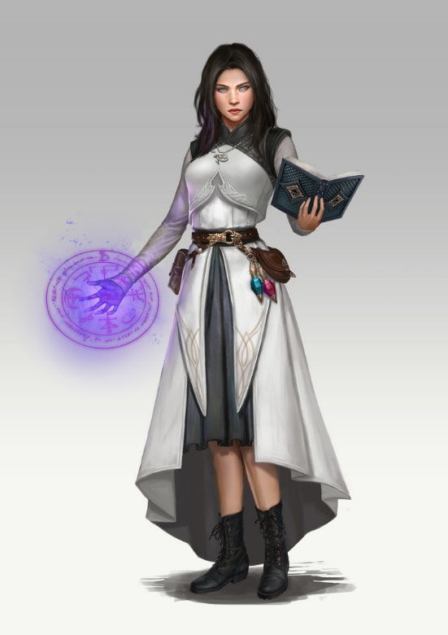



WISards Team DDI Challenge
Daphna Regev, Noa Raindel, Dikla Gelbard Solodkin,
Shira Kritchman, Chen Attias
Trax & Weizmann Institute of Science and Wizardry

Slide 2
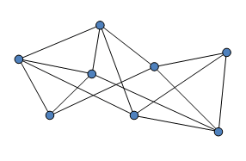
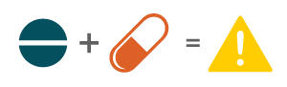
We aim to predict drug-drug interaction
Given an undirected graph G = (V, E) we predict missing edges
d1
?
d2

Slide 3
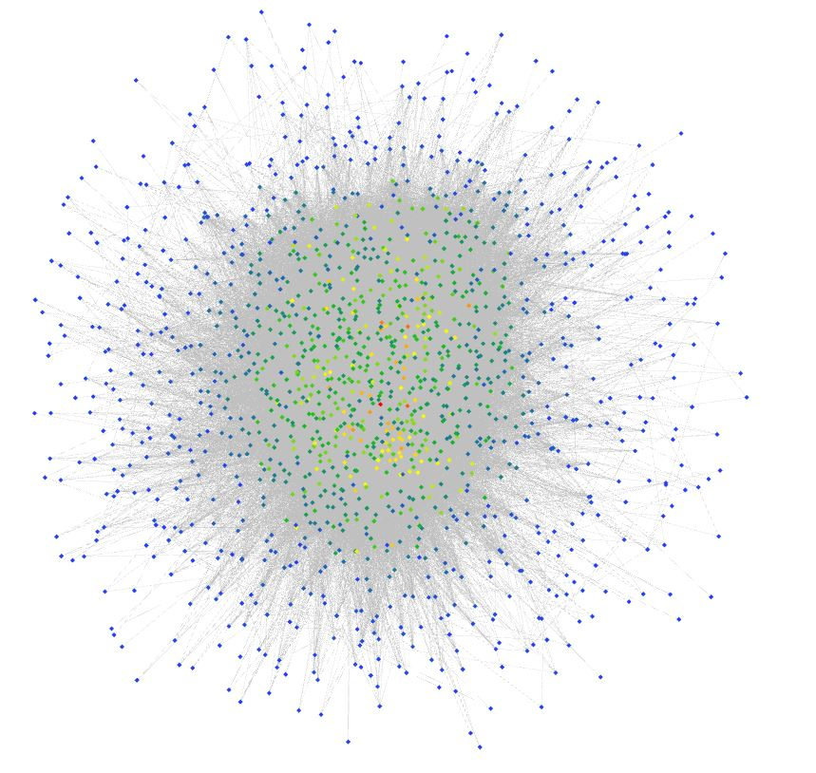
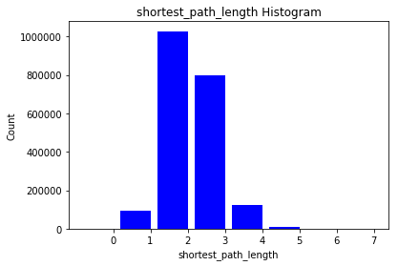
The graph shows small world phenomenon
Between 2 nodes:
Average shortest path is 2.5
Maximal shortest path is 7

Slide 4
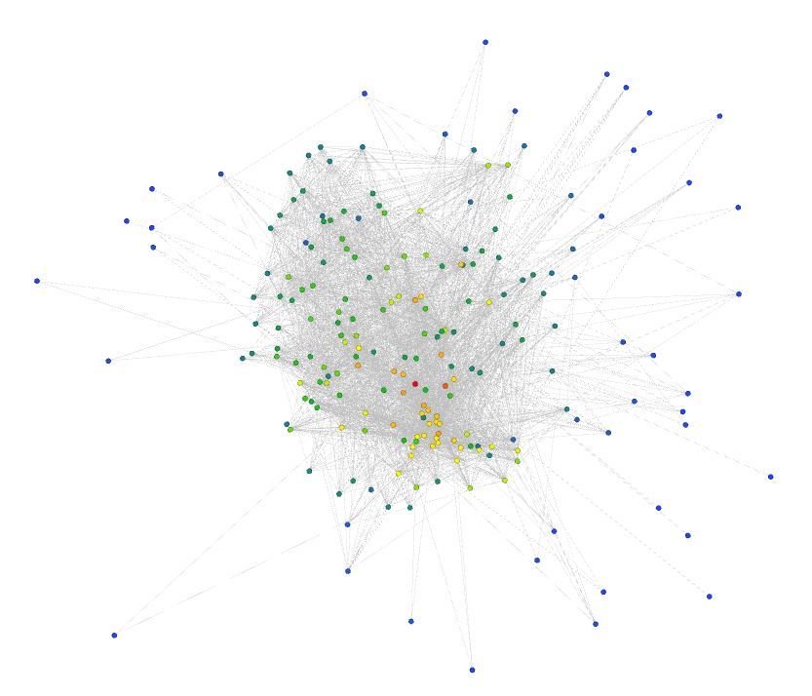
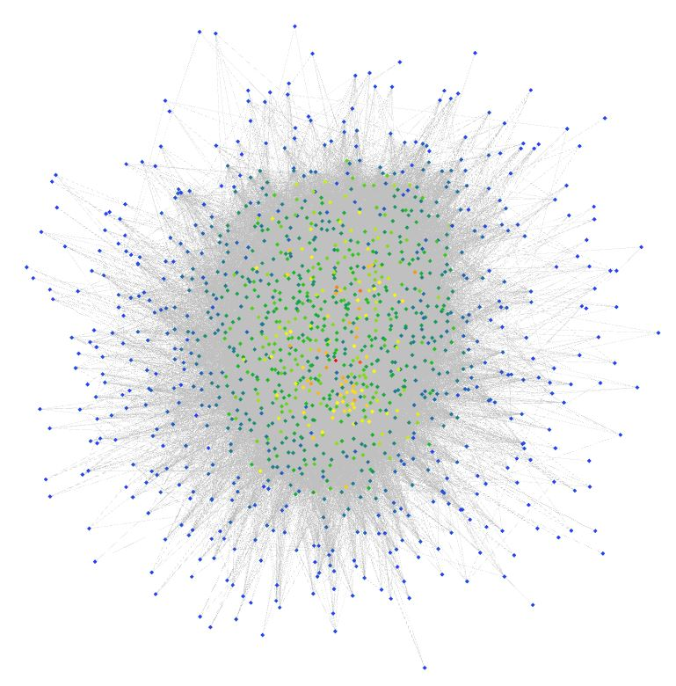
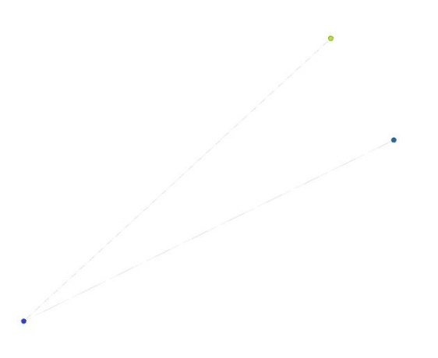
The graph has scale free effect
Most nodes have only a few links
A small number of hubs that have many links
Node 40, 1st degree neighbors
Node 40, 2nd degree neighbors
Node 40, 3rd degree neighbors

Slide 5
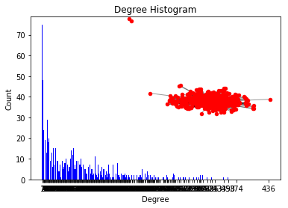
The graph has a giant connected component and power law degree distribution

Slide 6

The insights indicate similarity to social network, thus known link prediction models should work

Slide 7

However, drugs interact only between groups and not within groups
Two drugs interact when
They cause each other to be ineffective
Their combination is harmful

Slide 8

We assume there is a latent space of drug families and search for interactions between different groups

Slide 9
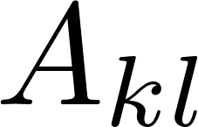
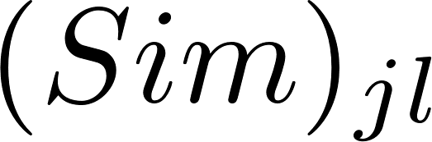
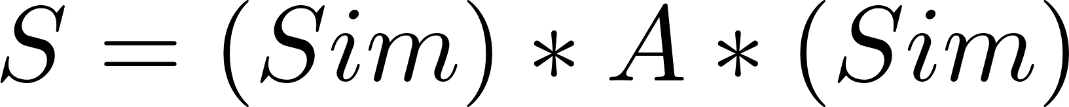
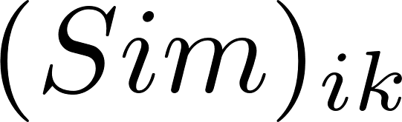
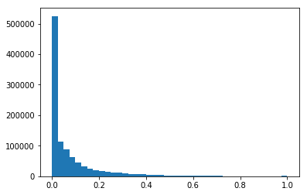
Sim-Conn searches for similarity of edges between nodes in different groups
k
l
Where (Sim)_{ik} is a similarity metric, based on Jaccard coefficient and cosine similarity
i
j
?

Slide 10
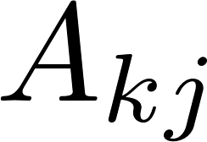
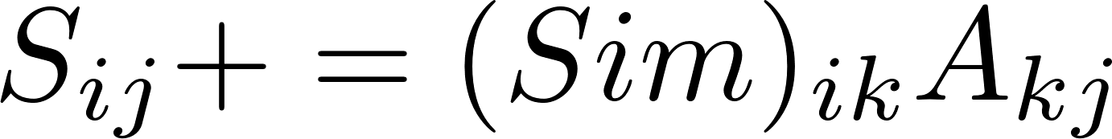
Inferring the probability of an edge using its 2-neighborhood produced better results
k
i
j
?

Slide 11
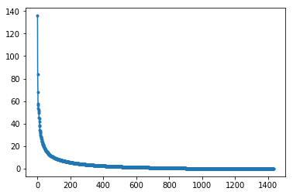
In a different approach, iteratively truncating singular values vector at knee point produced score matrix
Drop after ~120 singular values
50 iterations
Singular value
Order

Slide 12
Some models did not produce desired results due to time and computational limitations
Matrix completion algorithms
Using SDP – prohibitively slow
Random forest
Required additional time to optimize hyperparameters

Slide 13
If time permitted, we would have tried additional models
Use different implementation for matrix completion
Learn latent graph of components using neural networks
Ensemble a few models together

Slide 14
THANK YOU!!

